Slide 1
Project Based Learning Guide: Mrs. Chaitali Shewale
Dr. D.Y PATIL INSTITUTE OF ENGINEERING, MANAGEMENT & RESEARCH, AKURDI
CLASS :SE
DEPT. : ARTIFICIAL INTELLIGENCE AND
DATA SCIENCE

Slide 2
Topic-Contactless doorbell and Door lock
02 -Siddhant Shendge
12-Shubham Kambale
42 -Hetvi Patel
47-Pranjal Chaudhari
61-Shriya Pathak

Slide 3
Objective
The value of being able to remotely secure, unlock and open doors has been growing steadily.
The goals of this project were to build a modern, easy-to-use, smart door lock and doorbell that allows for accessible unlocking and adds convenience, utility, and security to your home

Slide 4
Problem Statement
To develop a touchless door-bell system with sensor-based technology to reduce the spread of contagious diseases like Covid-19

Slide 5
Scope Of The Project
The designed Touchless Doorbell is detecting a person who is visiting a home without touch
To set variable distance user can adjust is by its own. In general, we have sated the distance of person detection as 10 cm.
we have tested for 10-12 distances in the described range and the result was as per expectations.
This product functions automatically when a person comes in range of the sensor of touchless doorbell.
We also had taken care that the product should be economically affordable. We can place it anywhere we want and also the installation is pretty simple.
The setup of wireless doorbell doesn’t require any internal wiring

Slide 6
Limitations
The bell cannot detect person standing beyond 10 cm
The bell can detect the pets if the bell if fixed at lower distance from ground

Slide 7
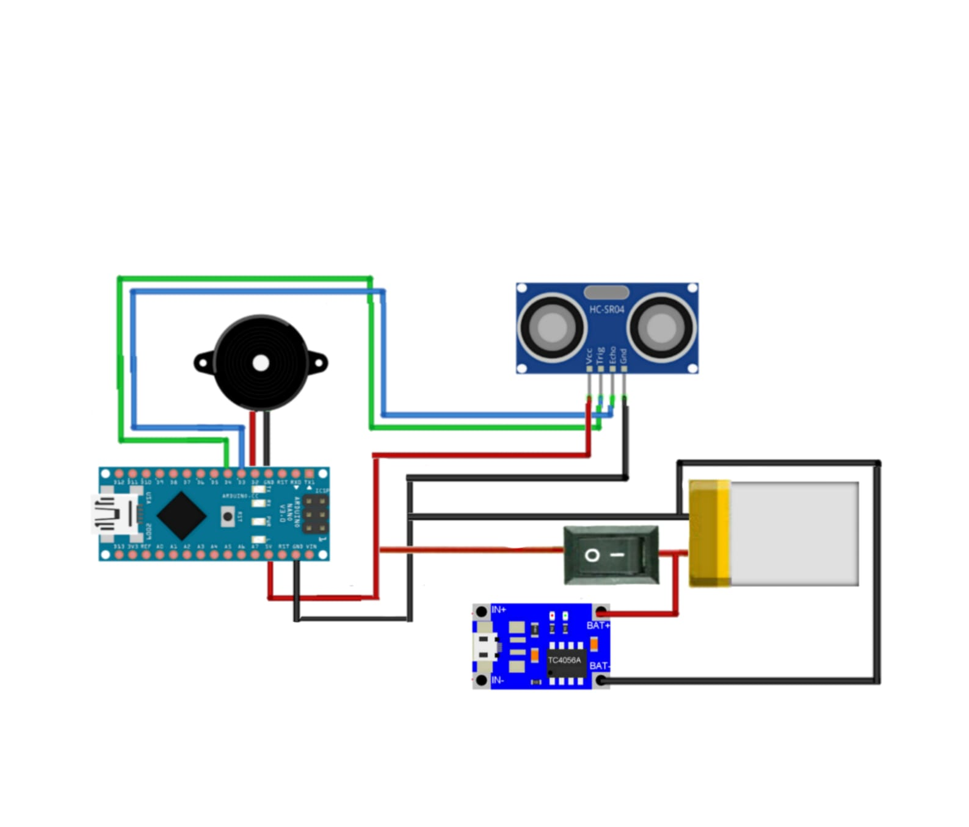
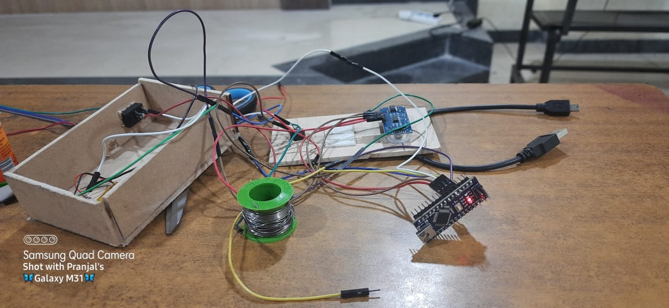
Implementation

Slide 8
Conclusion
This project is to bring more next level of enhancement in the security system.

Slide 9
THANK YOU!

